Slide 1
Development of Personality Theory
Students Name
Institute Of Affiliation
Date

Slide 2
Personality Theories
Psychodynamic
Social cognition
Trait
Humanistic
Notes:
Personality means modifications in characteristic patterns of intellectual, sensation and acting. Psychodynamic, social cognition, trait and humanistic are some of the perspectives that are used to explain personality theories.

Slide 3
Trait
Trait theory explains how organized, reliable, dependable, open-minded an individual is.
An introvert is a person who enjoys personal space or an extrovert who enjoys the company of other people for their good.
Neuroticism which is the ability for a person to control their negative energy.
Notes:
Introversion or extroversion are some of the traits that identify people’s personality (Cooper, 2019). Although traits can change to suit someone social life or career life, they will still enjoy their initial traits.

Slide 4
Humanistic
Humanistic theory is explained using Abraham Maslow of a pyramid of needs which explains from the basic needs which humans depend on them for survival at the bottom to the highest of self-actualization knowing one's purpose in life.
Humans are defined according to their needs and how these needs are met.
Abraham Maslow explains why basic needs are the first in his pyramid because humans cannot survive without the.
Notes:
As the pyramid goes up the human necessities decrease but they still strive higher to achieve them more then the basic needs.

Slide 5
Social Intellect
Social Intellect in this theory Albert Bandura explains that people tend to a copy behavior that seems to work for that individual.
For example, is a child being rewarded with a doll on excellent behavior this makes other children act in similar to attain such gifts.
It is also called common sense or tact gained from interacting with people and getting to know oneself (Dweck, 2017).

Slide 6
Psychoanalytic Theory
The psychoanalytic theory is explained by Sigmund Freud, who uses three mechanisms. These are Ego, id, superego.
Freud explains is that id tends to satisfy basic human wants without disregarding consequences and is the original instinct (Ferreira, 2019).
Superego control those instincts to align with social beliefs and norms.
It tends to make the individual think before acting.
Ego regulates the two to act in a civilized way of finding a civil solution.

Slide 7
Ideas on How Personality is Influenced
Culture Personality is subjective on ecological and living factors.
Culture is a critical environmental factor that forms personality.
Notes:
Personality is subjective on ecological and living factors. Culture is a critical environmental factor that forms personality (Novikova & Vorobyeva, 2019). For example, Western values cannot apply to other cultures like Indian or African cultures. Thus culture plays a vital role in a person's behaviour. The environment includes a place or the family setting a person was raised. For example, one family tradition is all family members must be available for dinner others are raised by the belief that they must attend a service on Sunday.

Slide 8
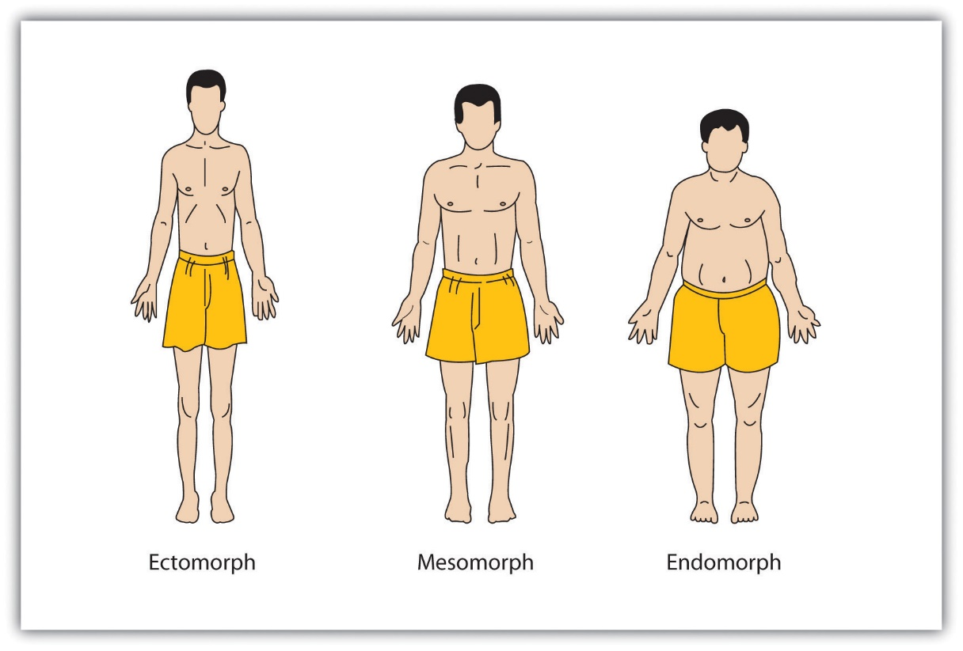
Somatology
Notes:
Somatology-William Herbert insisted the people who are thinner( ectomorphs) were likely to be introverts due to their low self esteem, endomorphs were expected to be cheerful with higher self esteem while mesomorphs were expected to be neutral (Wu& Chen, 2019).

Slide 9
Barnum Effect
Individuals trust when someone else explains their personality to them.
Barnum effect tells us why people believe in psychics, fortune telling, palm reading which they believe will explain more to them about their personalitites.

Slide 10
References
Cooper, C. (2019). Pitfalls of personality theory. Personality and Individual Differences, 151, 109551.
Dweck, C. S. (2017). From needs to goals and representations: Foundations for a unified theory of motivation, personality, and development. Psychological review, 124(6), 689.
Ferreira, S. J. (2019, October). Is financial risk tolerance influenced by personality traits?. In Proceedings of Economics and Finance Conferences (No. 9511451). International Institute of Social and Economic Sciences.
Novikova, I. A., & Vorobyeva, A. A. (2019). The Five‐Factor Model: Contemporary Personality Theory. Cross‐Cultural Psychology: Contemporary Themes and Perspectives, 685-706.
Wu, C. S., & Chen, T. T. (2019). Building brand's value: Research on brand image, personality and identification. International Journal of Management, Economics and Social Sciences (IJMESS), 8(4), 299-318.

